Slide 1
CS 451R Commerce Project SaveNScore
Group 5
Benjamin Rahman, Neil pirch, Donald Merrill

Slide 2
Project Requirements
A web application for Commerce Bank that allows customers to set budgetary goals in regards to saving
System requires gamification features; such as achievements, level systems, things like Fitbit and others of that nature
Database must be in SQL server or similar relational database
Responsive on smaller screens
Allows for multiple goals
Has a summary screen for customer
Different user roles such as family accounts
Functional login system

Slide 3
Our Design Choices
Server Language(s) and Framework
ASP.NET MVC
C#
ASP.net Identity for user authentication system
Already uses best practices for password protection and allows for two-factor authentication and external accounts.
Client Language(s) and Libraries
HTML, Javacript, CSS
Bootstrap for design framework
Jquery as a client-side scripting library
Database
Microsoft SQL Server

Slide 4
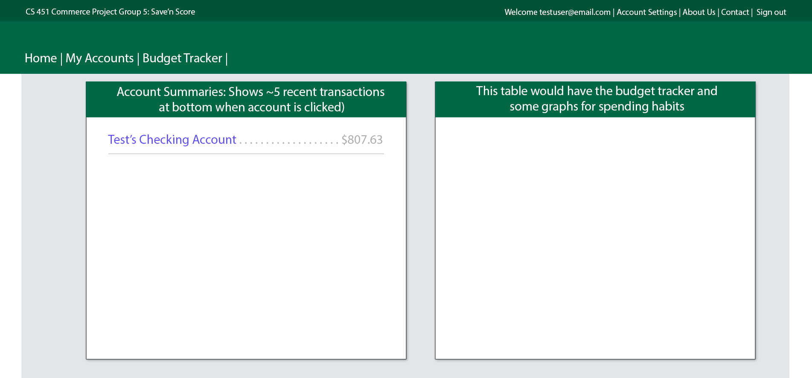
General Design Mockup for Later Iterations

Slide 5
Our Horizontal Prototype
Features placeholder design for navigation and general testing
Ensures that our database has preliminary tables such as:
transactions
budget goals
users (luckily required little modification from the default generated by ASP.NET Identity)
individual accounts
Viability testing for ideas, like how easy it would be to handle user-submitted goals
Lacks AJAX requests for single-page server requests
Lacks gamification features beyond tentative plans

Slide 6
Live Demo and Q&A

